Slide 1
The Care Economy in an Uncertain Future
Gretchen Donehower
University of California at Berkeley
13th Global Meeting on Population and the Generational Economy,
hosted by the East-West Center
August 3, 2020

Slide 2
Objectives
Give policymakers quantified data on the current care economy
Consistent over time, comparable across places
Includes paid and unpaid care work
Can be used with available population projections
Combine current estimates with change scenarios to envision impacts on future care economy

Slide 3
Roots of the Methodology
National Transfer Accounts (NTA) quantifies market-based consumption and production by age and sex
Pull out those pieces that relate to the care economy: childcare workers, home health aides, adult daycare workers, household service providers
National Time Transfer Accounts (NTTA) quantifies consumption and production of unpaid care work by age and sex
Direct care for children, elders, sick and disabled; indirect care through housework and household management

Slide 4
Snapshot – UCW Production
Unpaid care work (UCW)
Pooled 3-yr samples from American Time Use Survey
Age profile is smoothed avg time spent in those activities

Slide 5
Snapshot – UCW Production
Unpaid care work (UCW)
Pooled 3-yr samples from American Time Use Survey
Age profile is smoothed avg time spent in those activities

Slide 6
Snapshot – UCW Consumption
Imputed based on
Production estimates
Household structure
Imputation method differs by type of care
Direct versus indirect
Household member versus non-household member

Slide 7
Snapshot – UCW Consumption
Imputed based on
Production estimates
Household structure
Imputation method differs by type of care
Direct versus indirect
Household member versus non-household member

Slide 8
Snapshot – PCW Production
Current Population Survey
Age profile is smoothed avg time reported working in PCW occupations
Childcare workers
Home health aides
Adult daycare workers
Household service providers

Slide 9
Snapshot – PCW Production
Current Population Survey
Age profile is smoothed avg time reported working in PCW occupations
Childcare workers
Home health aides
Adult daycare workers
Household service providers

Slide 10
Snapshot – PCW Consumption
Imputed based on CE survey spending on personal services
Imputation method differs by type of care
Direct versus indirect
Adjusted to hours by matching to aggregate hours in PCW production estimate

Slide 11
Snapshot – PCW Consumption
Imputed based on CE survey spending on personal services
Imputation method differs by type of care
Direct versus indirect
Adjusted to hours by matching to aggregate hours in PCW production estimate

Slide 12
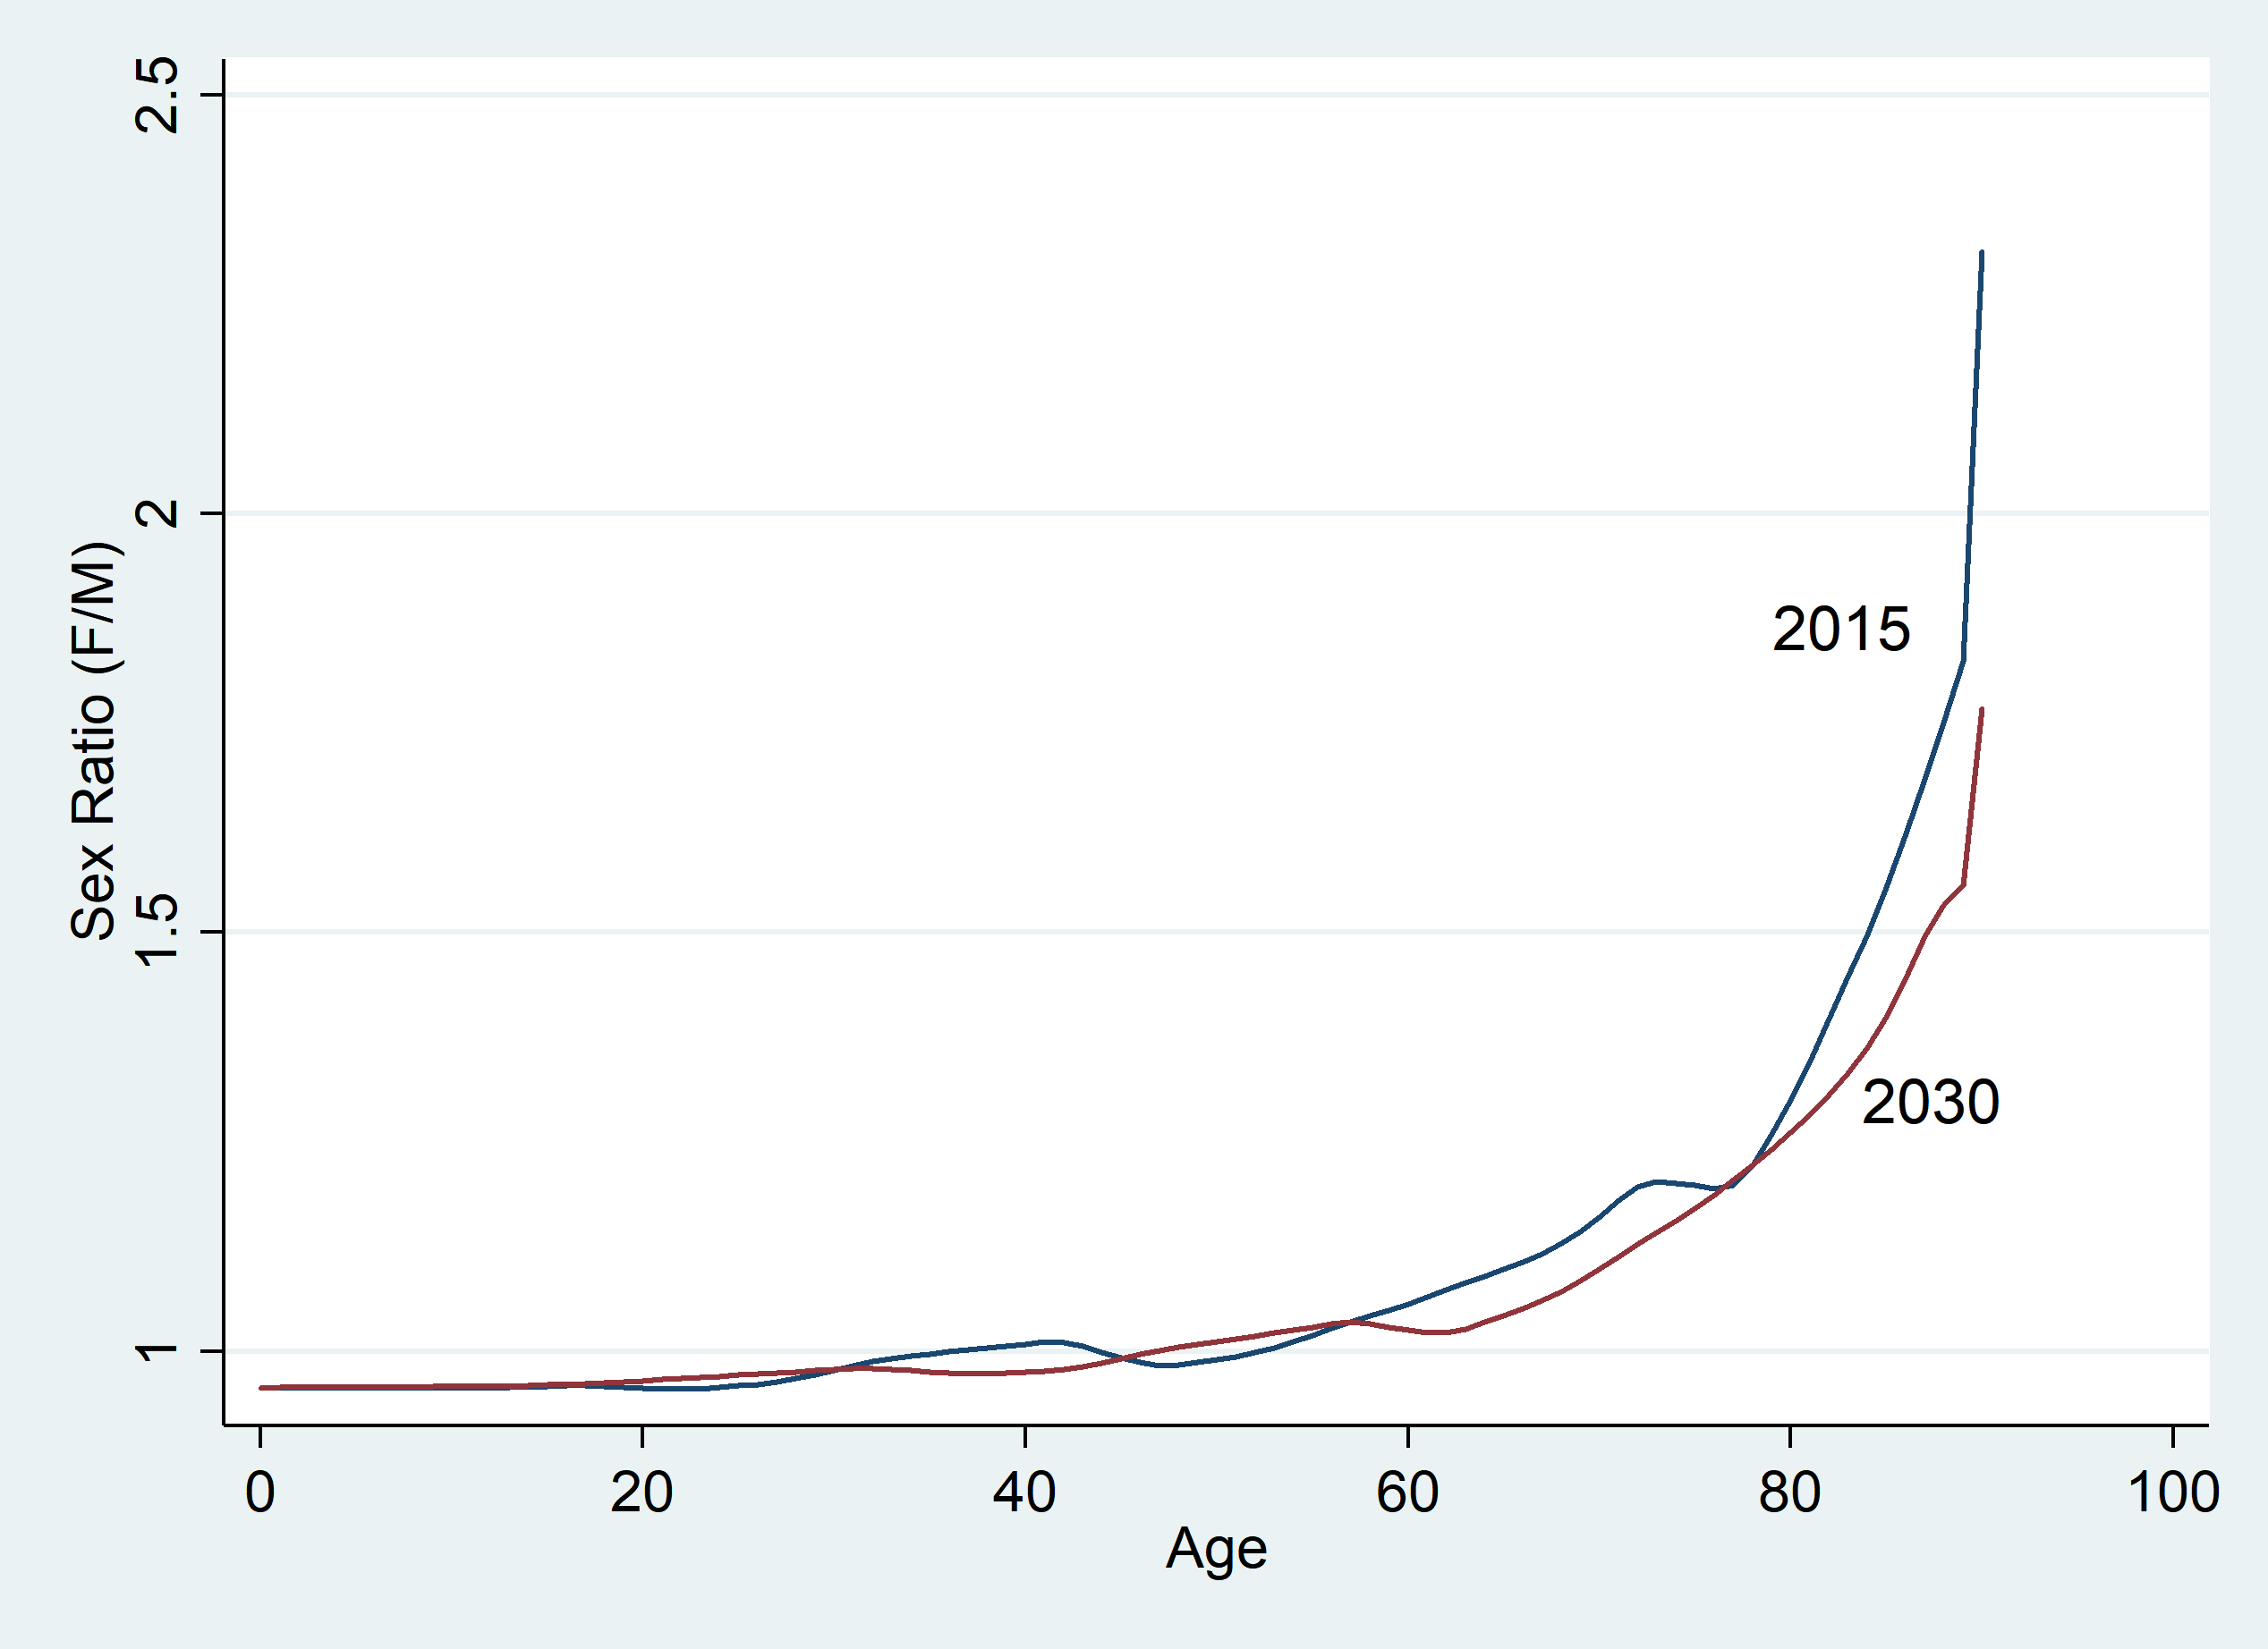
Context: Population Aging
How will care economy be impacted by aging?
Weight age profiles by population projections
Take ratios of aggregate care production / consumption (care support ratios)
Thought experiment: “if individuals stay the same but the population changes”

Slide 13
Care support ratios (2030 relative to 2015)
No evidence of supply shortfall
Time-expensive kids replaced by time-generative older persons
Picture changes over longer time spans and within different types of care

Slide 14
What could go wrong?
Schools *never* reopen?
Increases peak childcare burden by over an hour/day
Quantity-quality tradeoff
Childcare burden constant even with falling fertility
Increasing dementia prevalence
Erodes care support ratios but very sensitive to change scenario
Change in immigration policy that impact supply of PCW providers

